Slide 1
Human-AI Interaction
CS 344 2021-04-26

Slide 2
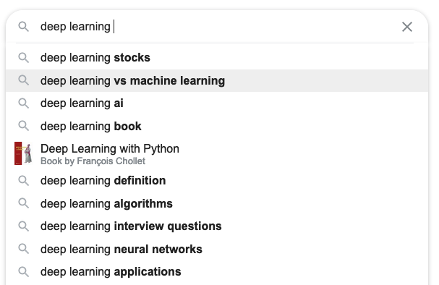

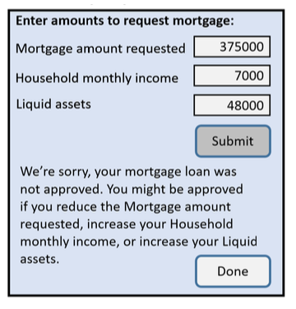

Slide 3
Main Points
Explainable ≠ interpretable
Models don’t have to be black-box to be accurate.
“Amplify, Augment, Empower, and Enhance People” (-Shneiderman)

Slide 4
Why care?
harms when systems aren’t reliable, safe, trustworthy
benefits when systems empower people

Slide 5
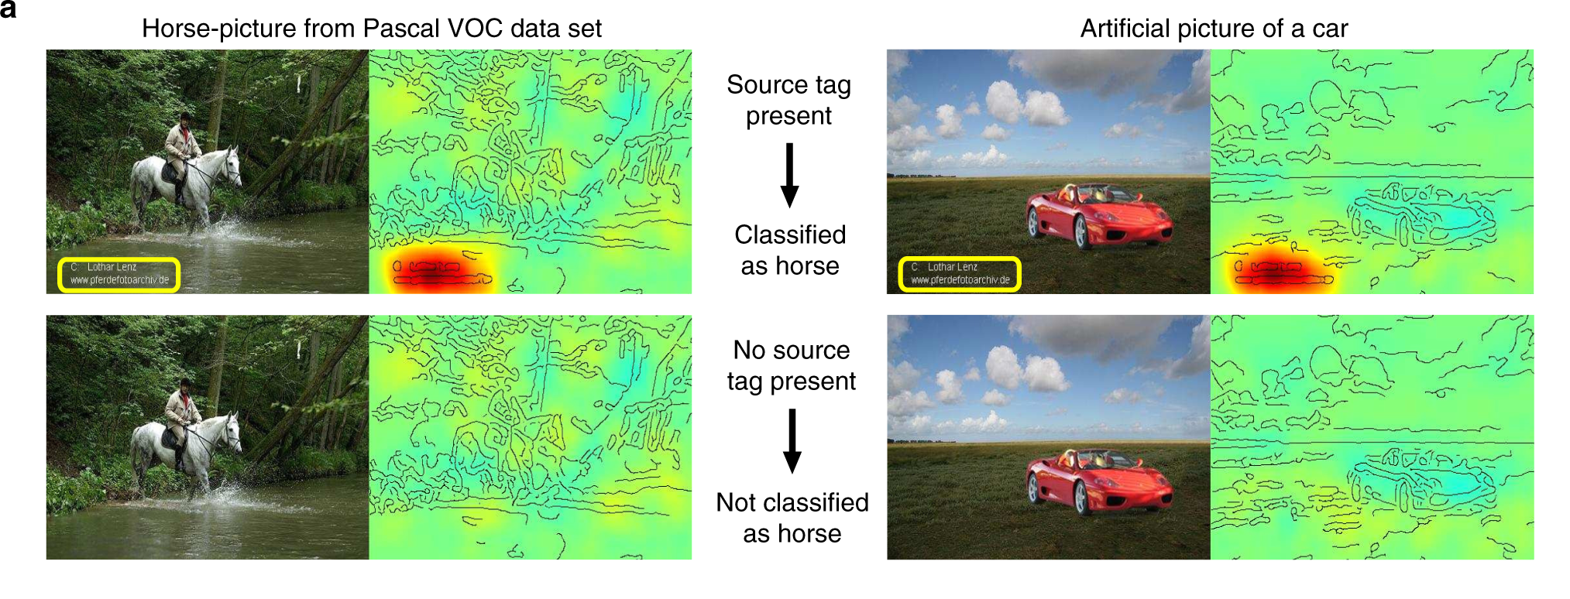
Lapuschkin et al. 2019. Unmasking Clever Hans predictors and assessing what machines really learn

Slide 6
Some Interpretable Models
All examples from Rudin et al. 2020, Interpretable Machine Learning: Fundamental Principles and 10 Grand Challenges

Slide 7
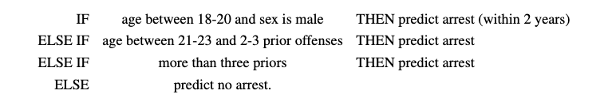
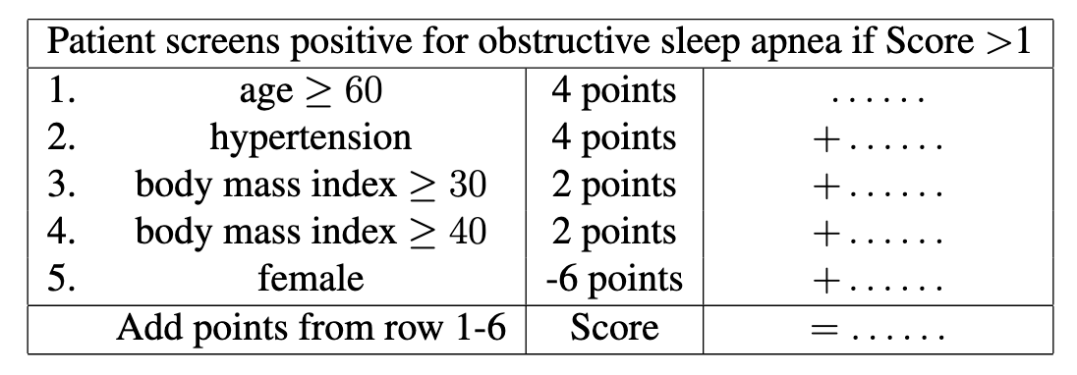
Rule lists and scoring systems
Angelino et al. 2017. Learning Certifiably Optimal Rule Lists for Categorical Data

Slide 8
Generalized Additive Models (GAM)
Score: risk of having diabetes.
plasma glucose concentration after 2 hours into an oral glucose tolerance test

Slide 9
Prototype-based, part-based

Slide 10
What if we need a black box model?
Can we “explain” such a model?

Slide 11
Dimensionality Reduction

Slide 12
Chefer et al. 2021, Transformer Interpretability Beyond Attention Visualization

Slide 13
Explainable vs Interpretable
Explainable: why did the black box model gave us this answer?
Interpretable: the model isn't a black box

Slide 14
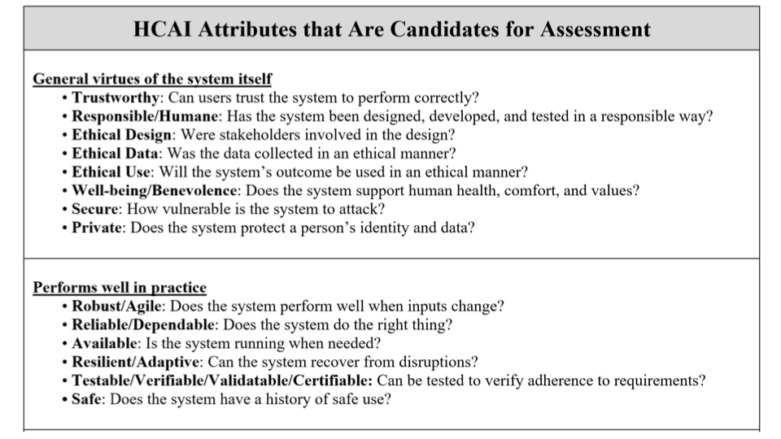
Ben Shneiderman – HCAI Tutorial at ACM IUI 2021 - https://iui.acm.org/2021/hcai_tutorial.html

Slide 15
